Slide 1
Web Development
-by Rajarshi and Aratrika Pal

Slide 2
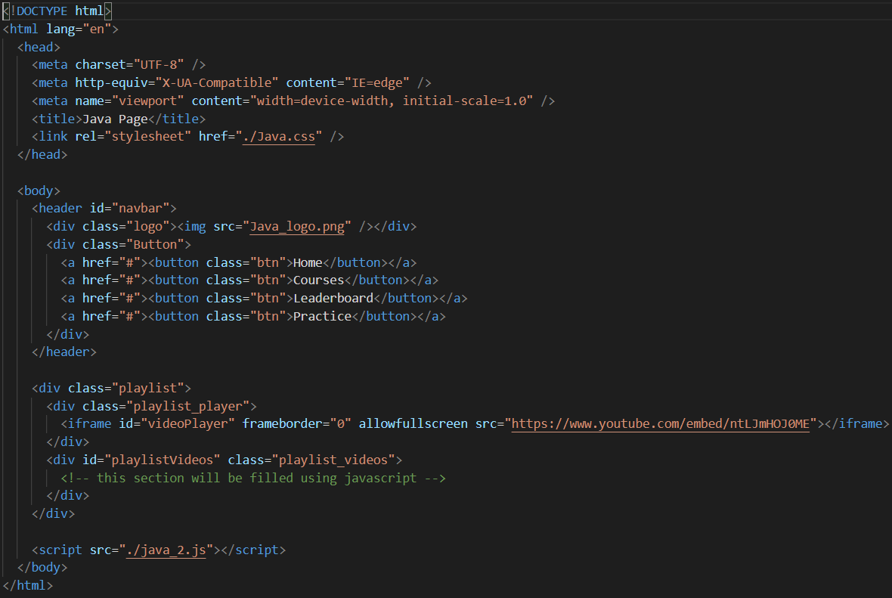
Java Tutorial Page
HTML Code:
In this page we have the tutorial videos for the java programming language.
Here , the tag <img> is used to embed an image in a web page .
And <iframe> that specifies an inline frame that is to embed another document within the current HTML document.

Slide 3
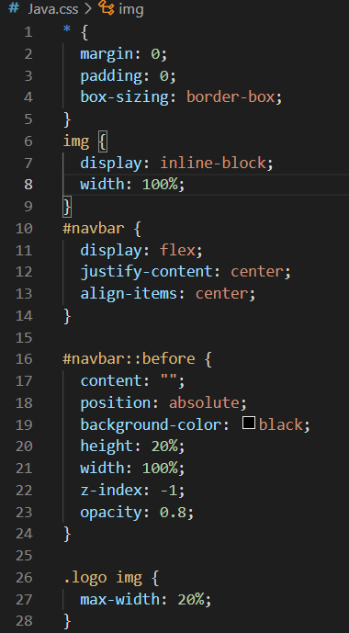
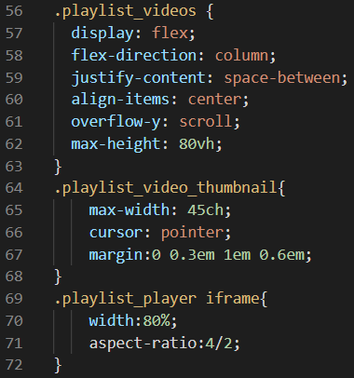
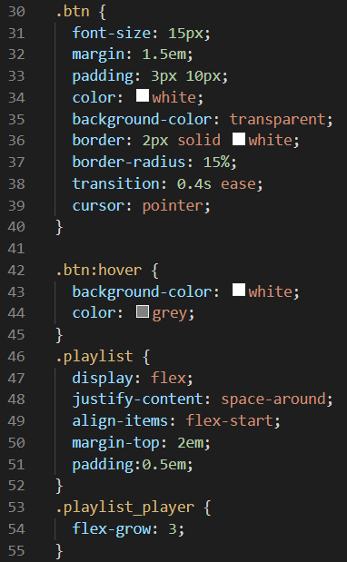
Java Tutorial Page
CSS Code:
Here we call the classes and ids that we have created in HTML page and decorate them separately.
Here we have created a top bar (id=navbar) and added colors, background-color , opacity(for the transparency)
We have embed a logo to the top bar.
The buttons are added under the class btn and btn: hover.
A thumbnail video is present and the playlist is also attached to it.

Slide 4
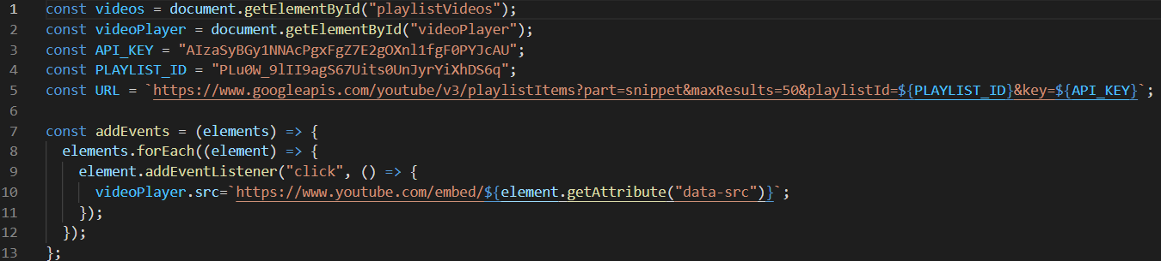
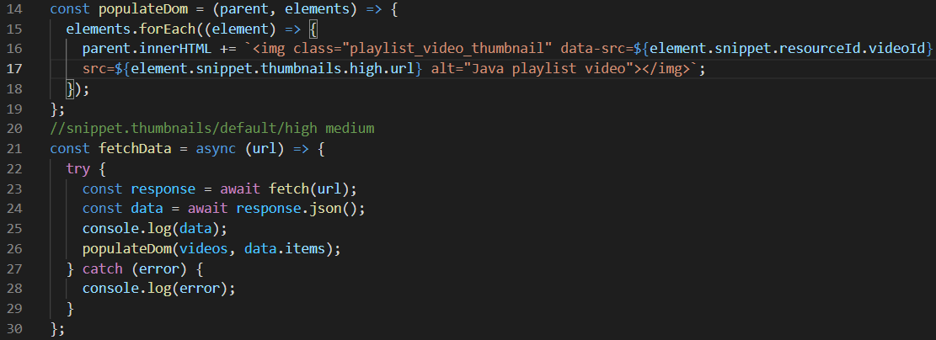
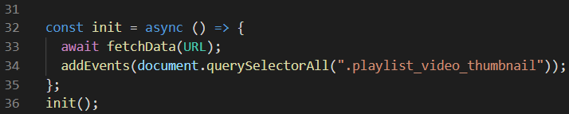
Java Tutorial Page
JS Code:
Various constants like videos , videoPlayer , API_KEY , PLAYLIST_ID are used.
Functions like addEvents is used to add the videos to be played in the thumbnail.
Functions like fetchData to play the video selected by the user in the thumbnail.

